Slide 1
Welcome

Slide 2

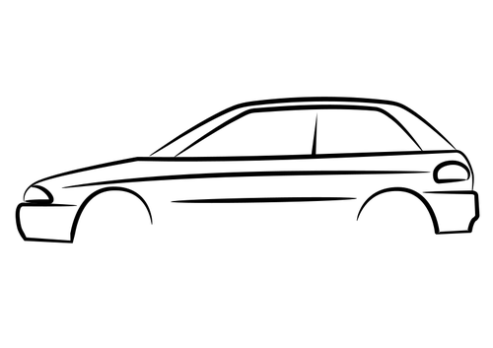
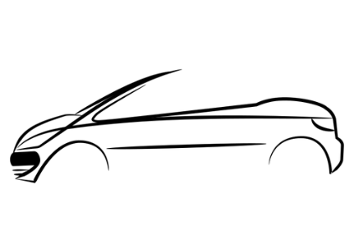
SSSSSSSSSSSSSSSSSSSSSSSSSS
Retro Car Game
0
0000
00
00
00000
0
0000
00
00
00000
SSSSSSSSSSSSSSSSSSSSSSSSSS
Console Based Retro Game

Slide 3


Overview of Game
A Retro Style Console based Car game set to run on the Windows Platform
Aimed at awakening the nostalgic vibe within the player of classic racing games
Single Player game with a simple control scheme
High-Score Leaderboard for competitiveness
Dodge incoming cars to advance score

Slide 4


Gameplay Mechanics
Avoid collision with oncoming vehicles and pass them. If crashed the game is over.
Score increments as each vehicle is passed, with the level increasing for each five points.
Speed increases as each level is advanced. The track gets narrower after level 5.

Slide 5
Gameplay Mechanics
12
Keyboard Control Configuration
A
D
Complete Level 12 to Win the Game
Steer Left
Steer Right
Easy
Medium
Hard
Three Difficulties to choose from for faster oncoming cards

Slide 6
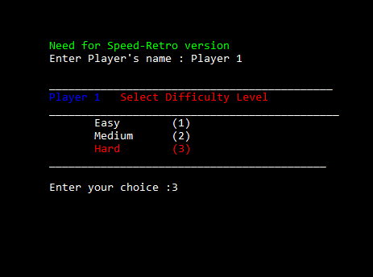
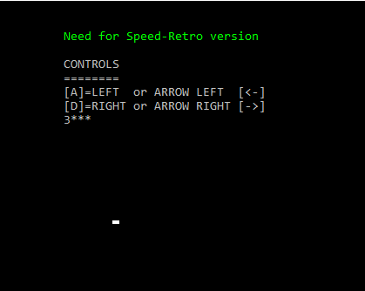
GUI of the Game
Splash Screen
Controls Screen

Slide 7
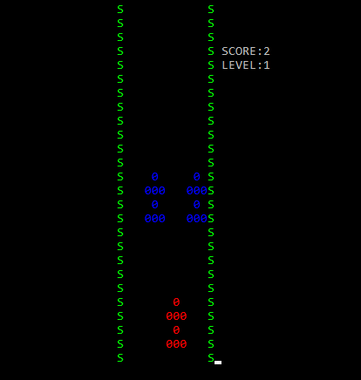
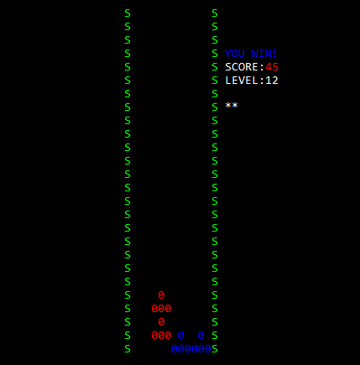
GUI of the Game
Gameplay Screen
Victory Screen

Slide 8
Project Work Delegation
Isuru Herath
Project Manager and Head Designer
Lasitha Gajanayake
Game system and infrastructure programmer
Shanilka Illankoon
Aesthetic element programmer and documentation
Daksith Jayasinghe
Technical writer and mechanics programmer
Nuwan Jayaweera
Interface designer and documentation

Slide 9
Design Process
Waterfall Model
Requirements
Understanding the required product, the scale and features to be included
Design
Designing the overall game elements such as visual aspects and gameplay
Implementation
Writing the code for each function according to the design
Testing
Testing the game and checking each aspect of the code to fix errors and improve the experience
Maintenance

Slide 10
Stages of the Project
Game Design/ Project Proposal
Game Development – Splash Screen of the Game
Game Development – Road Track
Game Development – Player Control
Game Development – Computer Controlled Cars
Game Development – Scoreboard
Testing And Maintenance
Project Documentation

Slide 11
Thank You and Happy Gaming!
SSSSSSSSSSSSSSSSSSSSSSSSSSSSSSSSSSS
0
000
0
000
0
000
0
000
0
000
0
000
SSSSSSSSSSSSSSSSSSSSSSSSSSSSSSSSSSS

